Slide 1
Role of the Coalition Medical Director During COVID
Presenters:
Dr. Jerry Evans, MD, MMM, FACEP
Luke Aurner, PEM, CCEMT-P I/C
Copyright 2022. MI_Region_6_HCC. All rights reserved.

Slide 2
Disclaimer
This presentation is meant to provide information about the COVID response in the Michigan Region 6 Healthcare Coalition.
Opinions expressed in this presentation are that of the speakers and not necessarily that of the Michigan Department of Health and Human Services.

Slide 3
Objectives
In the presentation we will:
Give an overview of the Healthcare Preparedness Program and the Medical Director’s involvement in Michigan.
Explain
Give an example of Day to Day operation versus incident response operations.
Review the involvement of the Medical Director during the COVID-19 pandemic response.

Slide 4
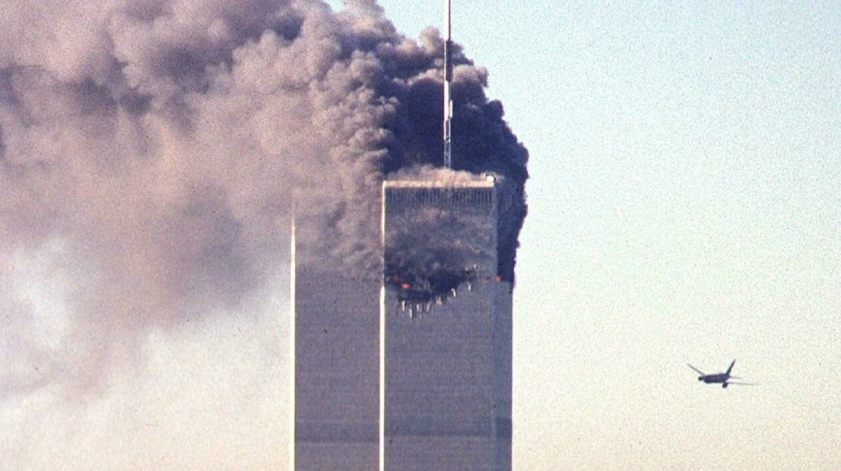
Let’s start from the beginning……

Slide 5
Healthcare was not ready for large-scale disasters.

Slide 6
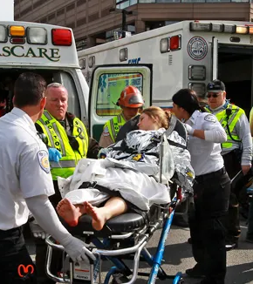
Communications
And
Coordination

Slide 7
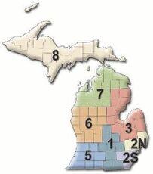
In Michigan

Slide 8
Full-Time Coordinator
Full-Time Assistant Coordinator
(Started as PT)
Part-time Medical Director

Slide 9
Medical Director
Practicing Physician in Emergency Medicine
Most involved in EMS
In Michigan Region 6:
Emergency Room Physician
Medical Control Authority Medical Director – Muskegon County

Slide 10
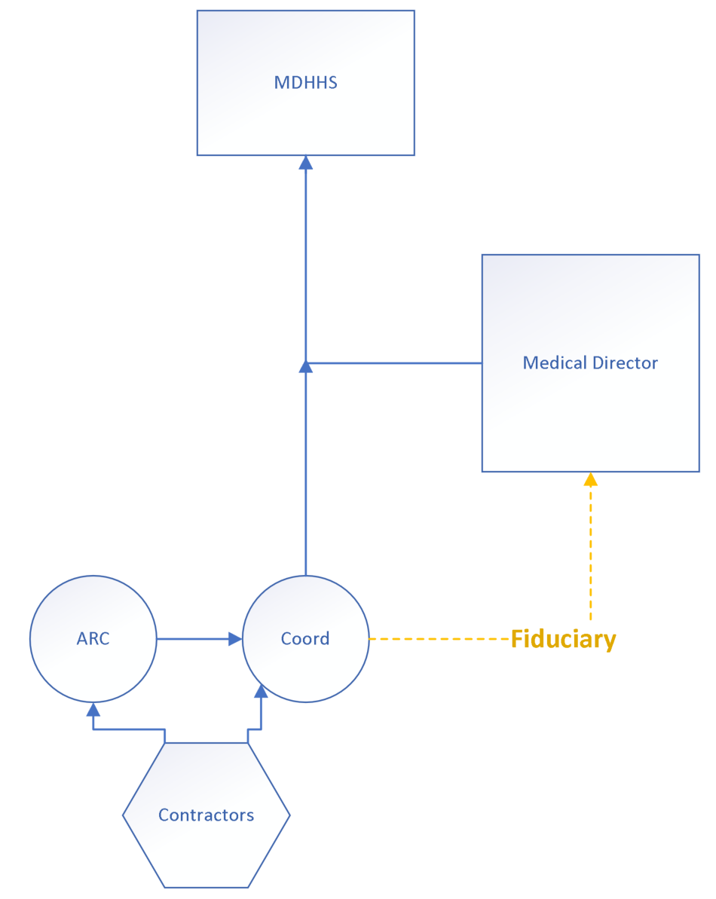
Day to Day Operations

Slide 11
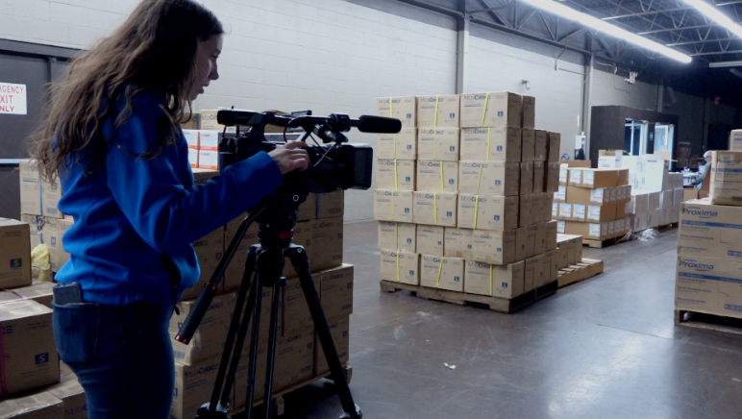
Specific Work
Medical Directors
CMO
CNO
Politicians
Public Information Officer

Slide 12
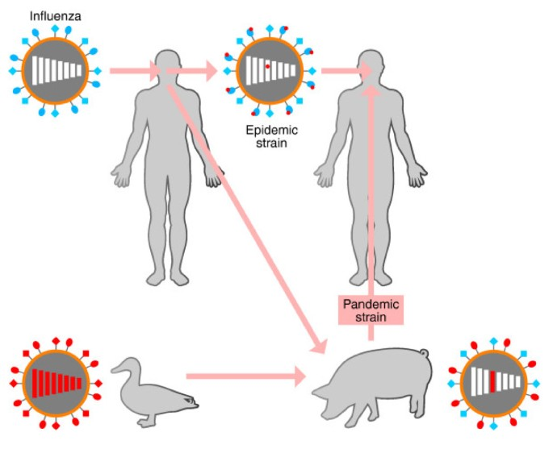
20 Years of Involvement
Influenza H1N1
Smallpox
Ebola
Nerve Agents
Helped identify strategies in planning and preparing for the outbreak.
BMC Biology

Slide 13
20 Years of Involvement
Influenza H1N1
Smallpox
Ebola
Nerve Agents
Helped foster direct communication with hospital leadership around the region and state.
Mydr.com.au

Slide 14
20 Years of Involvement
Influenza H1N1
Smallpox
Ebola
Nerve Agents
Assisted in the development of a response plan. Worked directly with the SPRN treatment center to identify how the region could be involved.
CNN.com

Slide 15
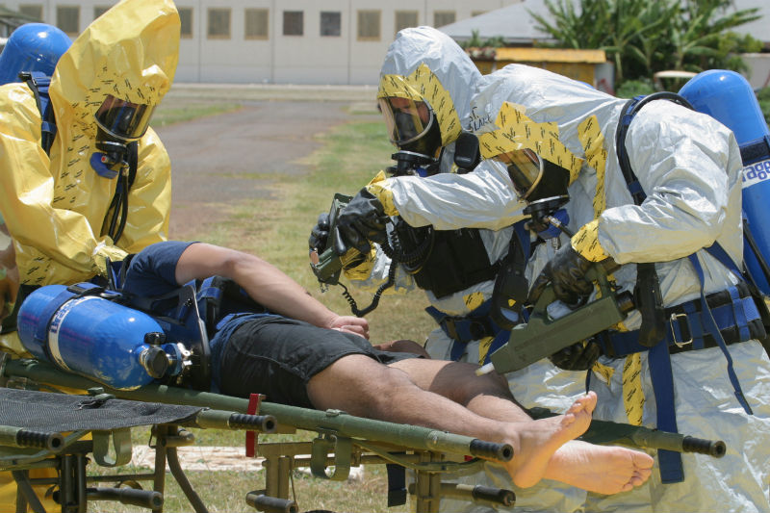
20 Years of Involvement
Influenza H1N1
Smallpox
Ebola
Nerve Agents
Verified best treatment courses.
Assisted in the development of education for hospital and prehospital staff.
www.open.edu

Slide 16
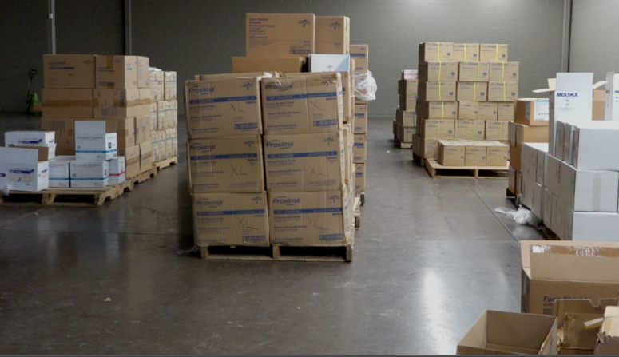
Specific medical knowledge is critical to coalition decision-making.
Medications to stockpile
Equipment to purchase
Protocols for EMS and clinical pathways for hospitals
Ensuring decisions are clinically relevant

Slide 17
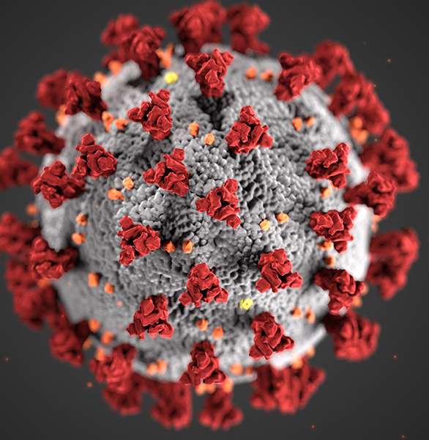
COVID-19
www.cdc.com

Slide 18
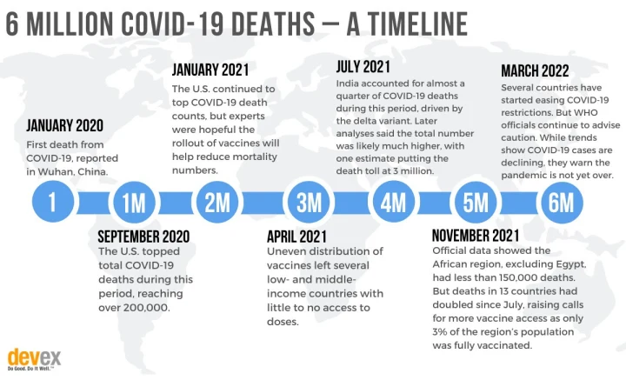
Devex.com

Slide 19
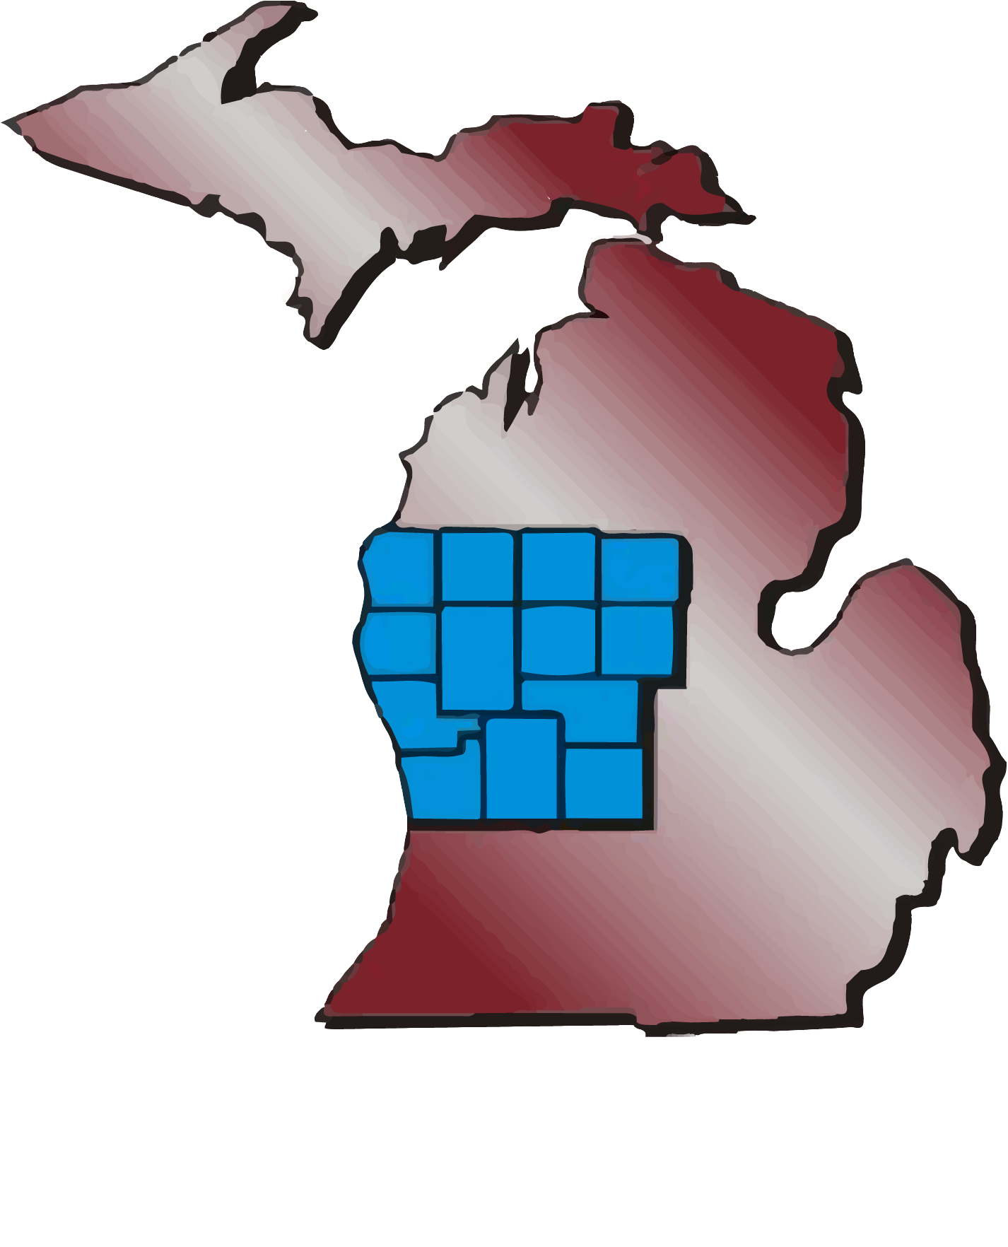
COVID in Michigan Region 6
First cases in March 2020
Large outbreaks on the East side (Detroit)
Medical Directors, working with MDHHS, researching best practices for the regional partners

Slide 20
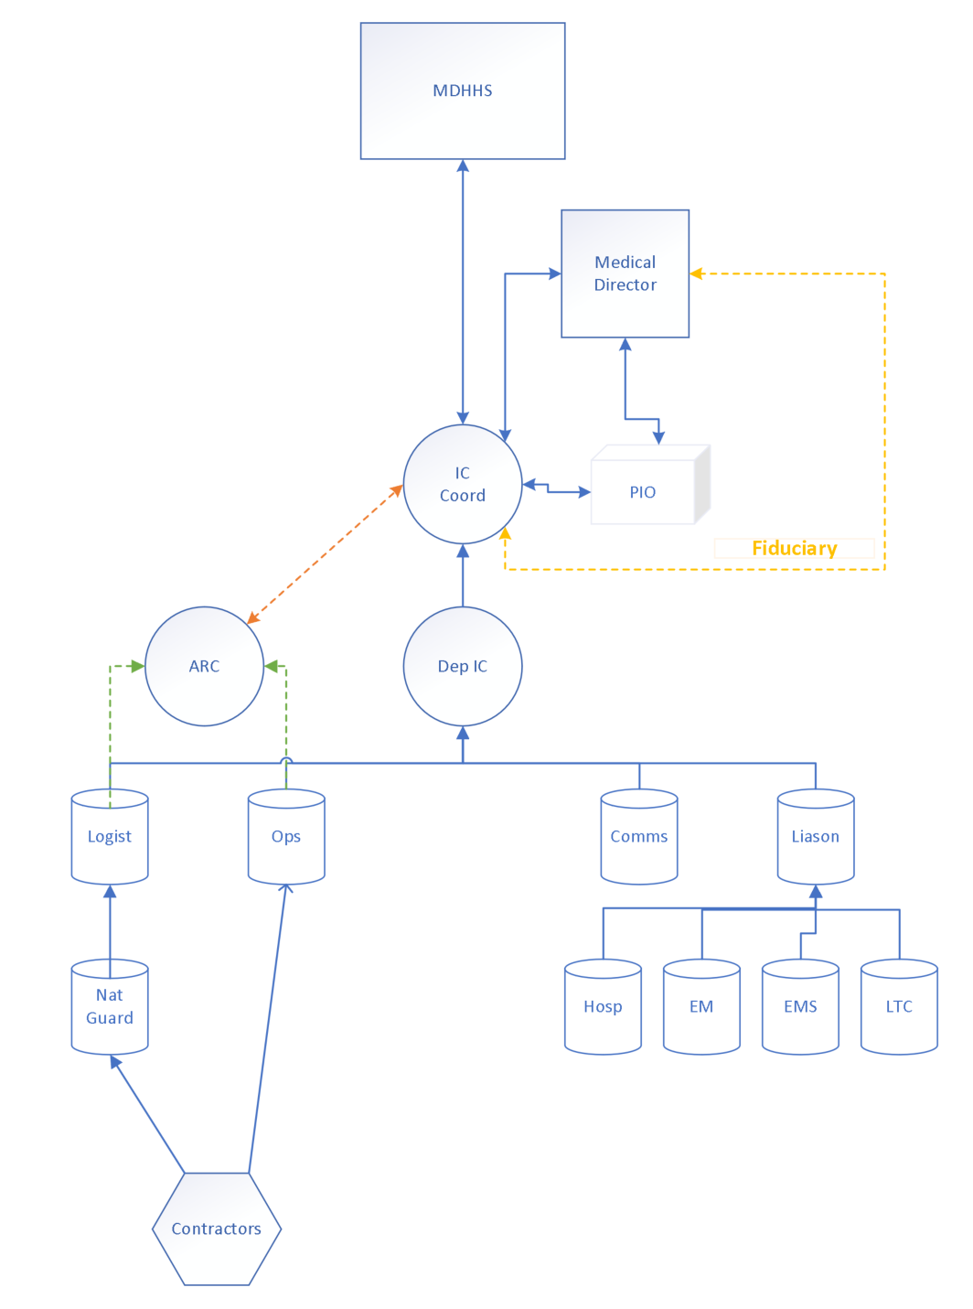
Chain of Command
Full-time Emergency Physician.
Responsibilities to Hospital and colleagues

Slide 21
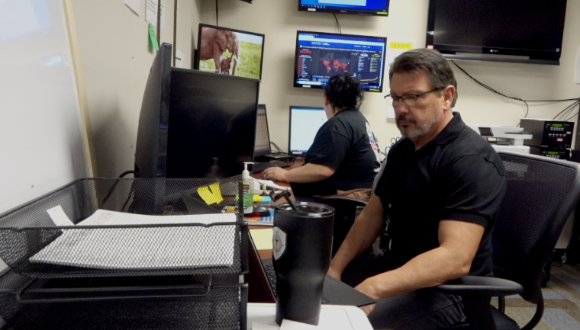
Communication

Slide 22
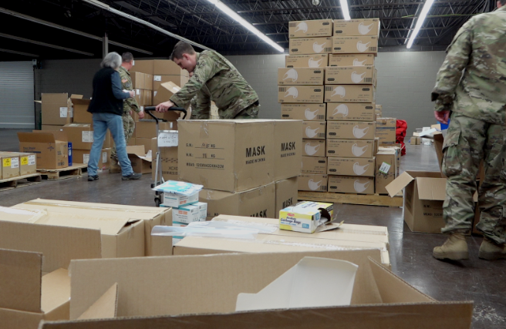
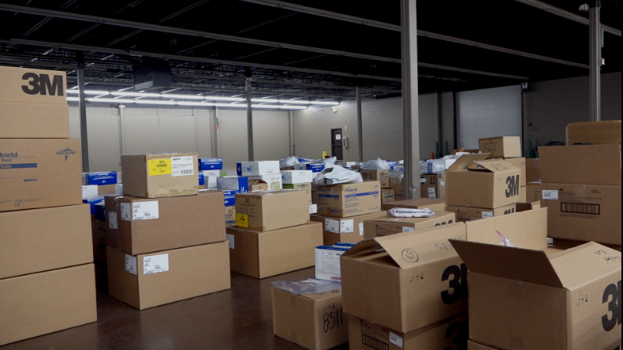
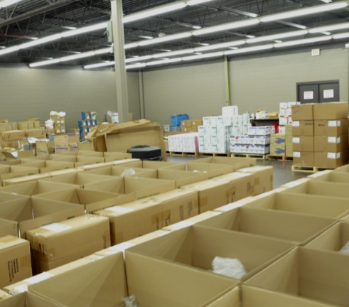
PPE Distribution

Slide 23
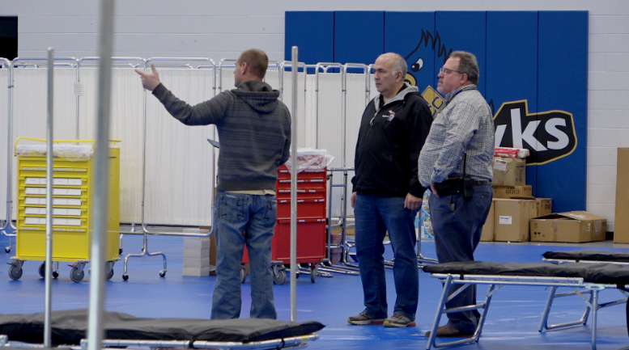
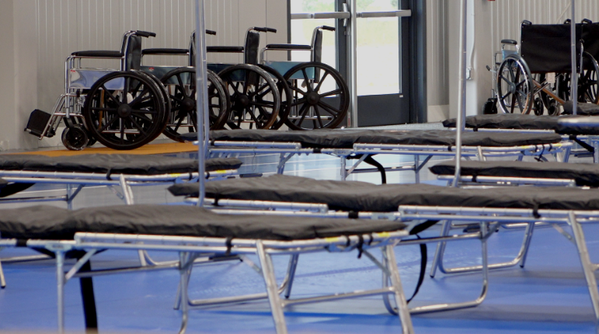
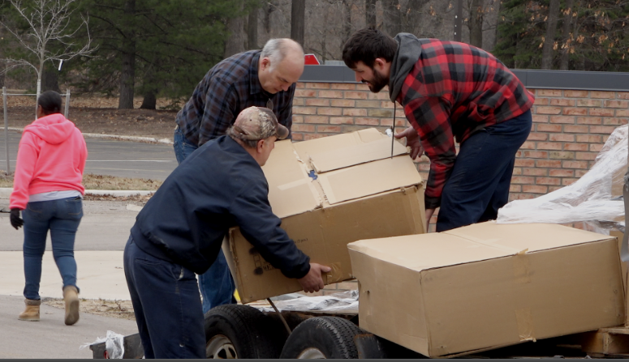
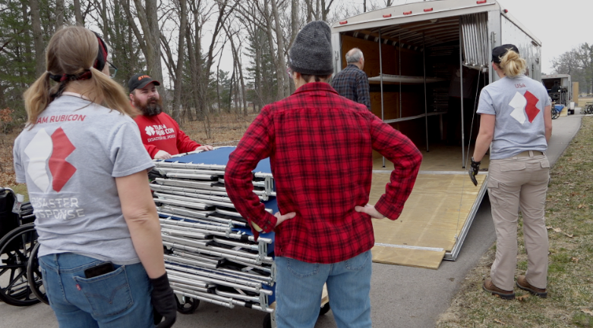
Alternate Care Site

Slide 24
Leadership calls
Calls weekly with CEO, CMO, and CNO.
Direct leadership conversations.
Broke down barriers.
Bringing preparedness information. directly to decision-makers.

Slide 25
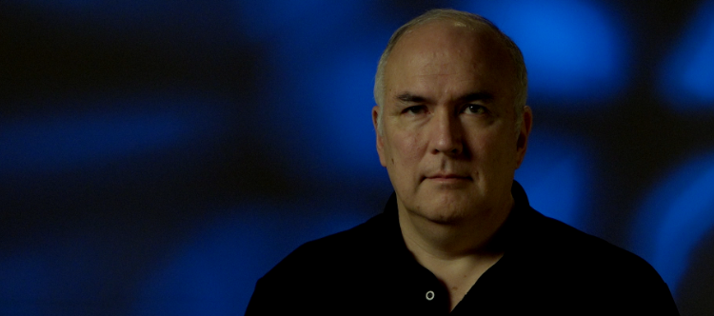
Direct partner support
Facilities that do not have medical directors
Group Homes
Adult Foster Care Homes
Backup support for other regions when the medical director is away.

Slide 26
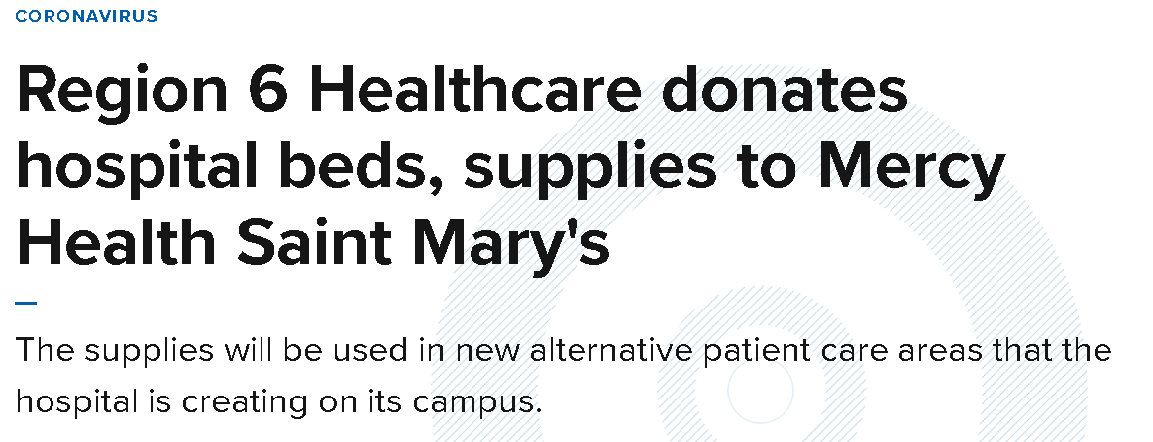
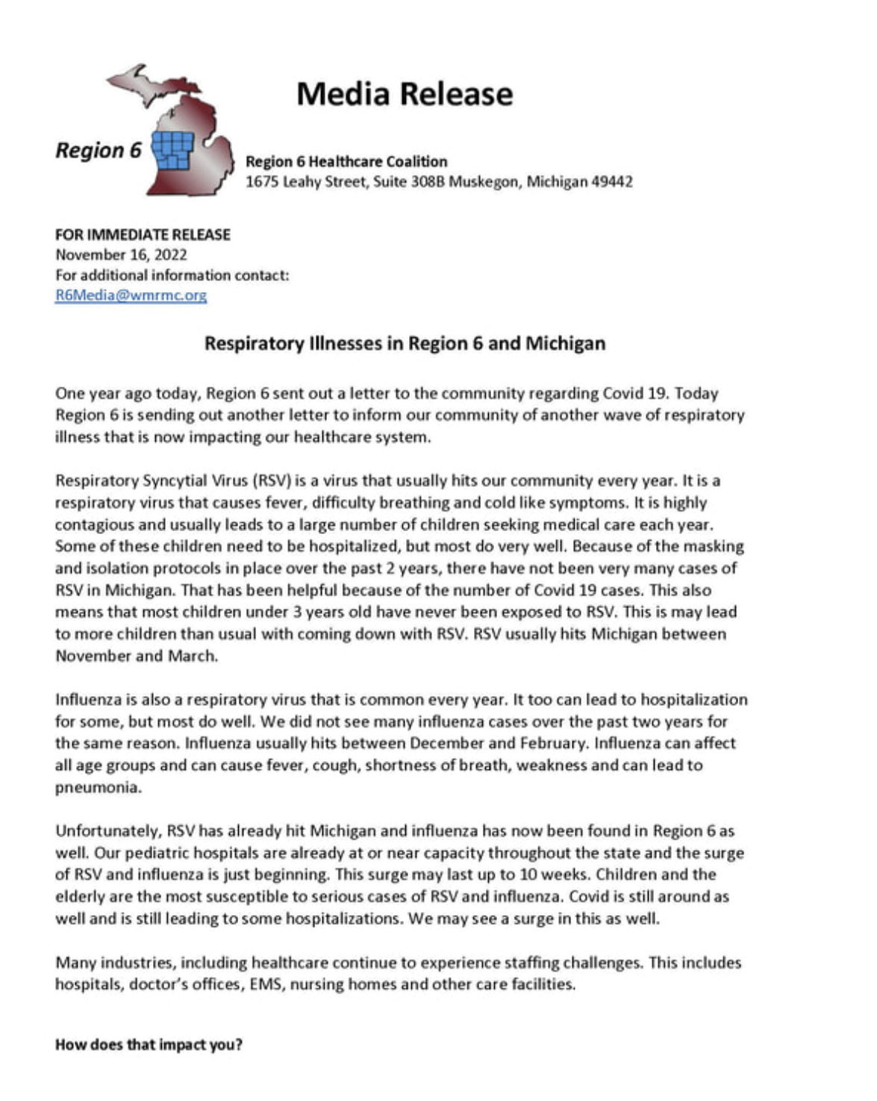
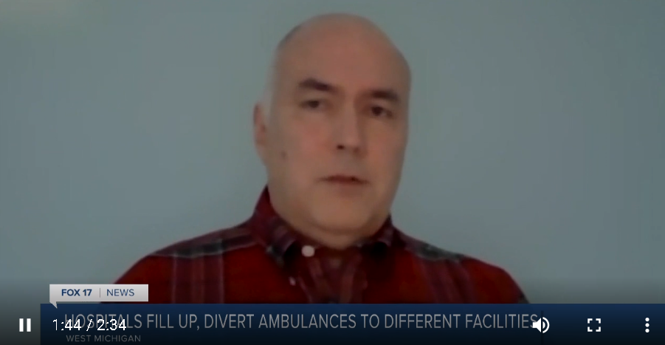
Press

Slide 27
Medical Director to Medical Director
8 HCC Medical Directors in Michigan

Slide 28
Conclusion
Medical directors are an essential component in the success of the Healthcare Coalition programs in Michigan.
Clinical input for both Regional and State decisions and issues.
Provide a level of expertise.
Help move the state forward as one entity.

Slide 29
Dr. Jerry Evans, MD
Chief of Staff, Trinity Health – Muskegon
Michigan Region 6 Healthcare Coalition Medical Director
Muskegon County Medical Control Medical Director
CEO- West Michigan Regional Medical Consortium
Luke Aurner, PEM, CCEMT-P I/C
Coordinator, Michigan Region 6 Healthcare Coalition
1675 Leahy St, Suite 308B Muskegon, Michigan, 49442 231-728-1967 www.miregion6.org

